Slide 1
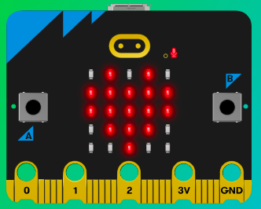
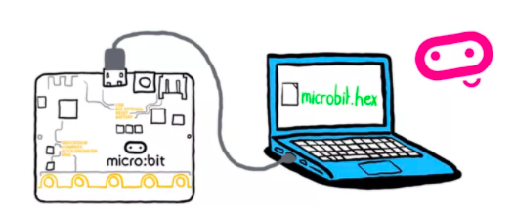
MicroMakers!
KIDS’ MAKER CLUB OF WASHINGTON, DC
Meet Up #9
And Now for Something Completely Different…

Slide 2
RECAP!
Magnetometer Sensor
Compass
If, Then, Else
Variable
Loop
Inputs, Outputs, Processor
Notes:
LEDs, Buttons, Light Sensor

Slide 3
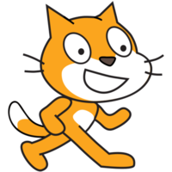
SCRATCH!
The First Drag + Drop Visual Coding Language for Kids

Slide 4
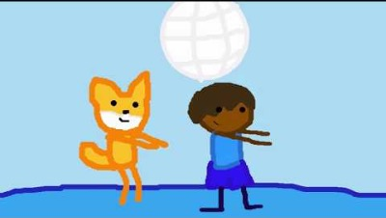
What is Scratch?

Slide 5
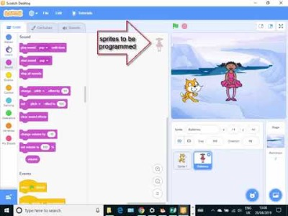
How Do I Use Scratch?

Slide 6
Let’s Set up Scratch Accounts!
Guidance
Go to https://scratch.mit.edu/
Think of a username (which should not include your real name) and password (that you have never used before and will not use in another application). Write these down in your Lab Notebook, so you do not forget them
You’ll need an email address to register. Don’t have one? Ask teacher for help.
When signing in, pay attention if you need to check the Captcha box!

Slide 7
CLOSE YOUR COMPUTERS!
We know you can’t wait to get started…but listen up!

Slide 8
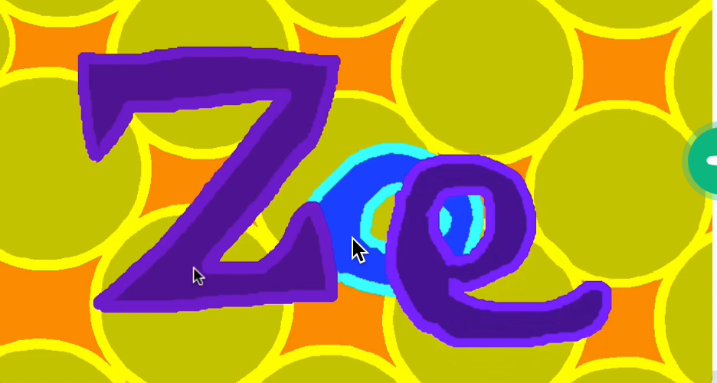
Step 1: The Project Animate Your Name!
What is it?
Create an interactive name project – when you click different letters of your name, have them do something fun!
What do I need?
Scratch coding environment.

Slide 9
Step 2: How Does it Work?
First, select a Backdrop for your program.
Then, click Create, to create a new ”sprite” using the Sprite Library – choose the first letter of your name in the “Letters” tab.
Next, make your sprite do something when it’s clicked – move, change color, make a sound, etc. Use the Coding Cards for Continue creating actions and sounds for the first letter of your name.
Repeat for each of the remaining letters of your name!

Slide 10


Step 2: How Does it Work?
Scratch is a super fun coding platform, with which you can do lots of neat things. PLEASE DO NOT GET DISTRACTED and try to finish this assignment, as given: make each letter of your name interactive.
A good coder keeps their eye on the prize and completes a program’s key functions before adding what we call bells and whistles.

Slide 11
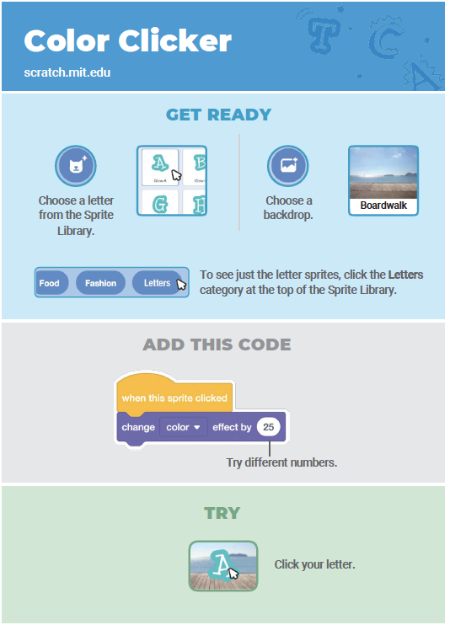
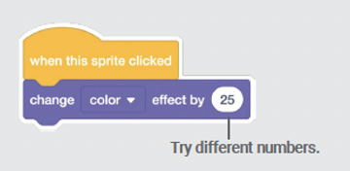
Step 3: Read It and Code It

Slide 12
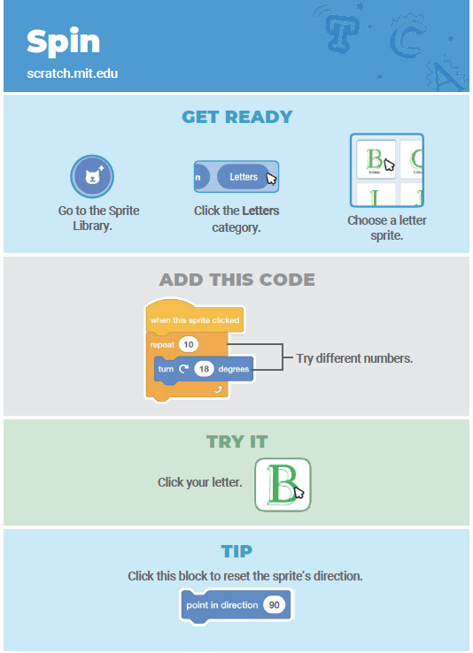
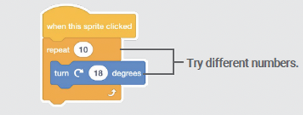
Step 3: Read It and Code It

Slide 13
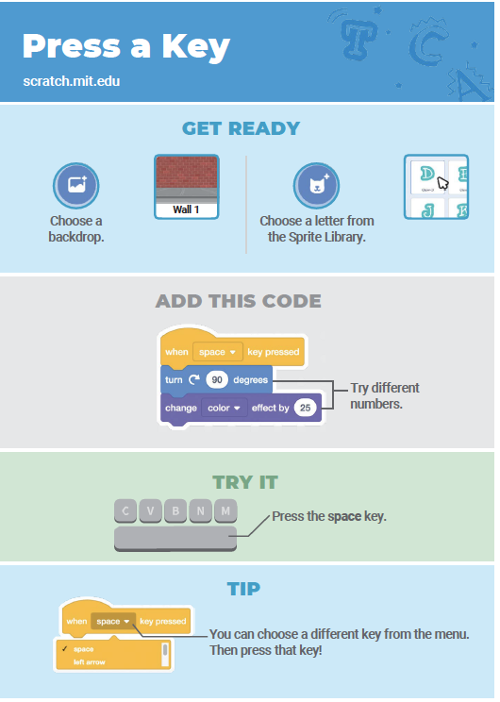
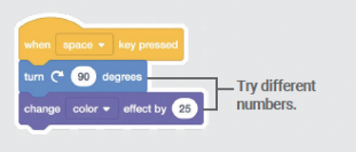
Step 3: Read It and Code It

Slide 14
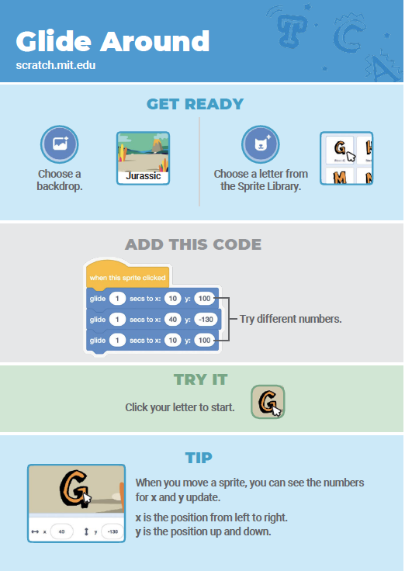
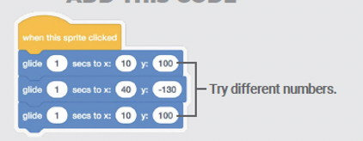
Step 3: Read It and Code It

Slide 15
Step 4: Share Your Creation!

Slide 16
Step 5: Improve It
Try drawing your own letter!

Slide 17
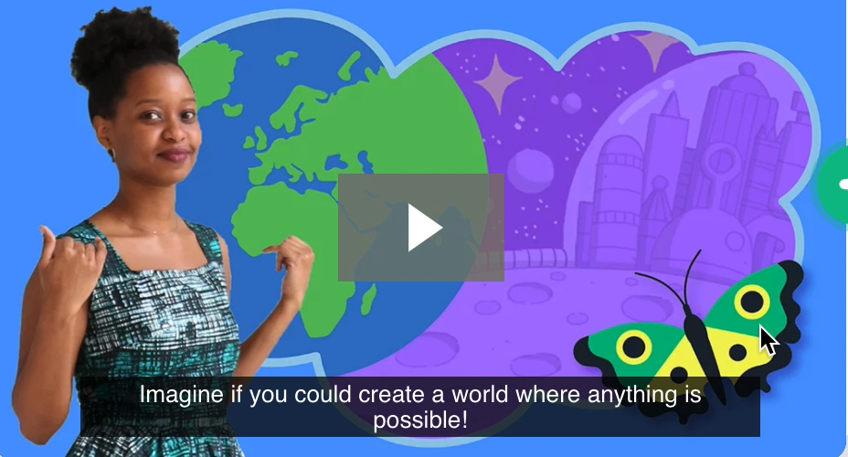
Step 1: The Project Imagine a World
What is it?
Create your own digital world!
What do I need?
Scratch coding environment.

Slide 18
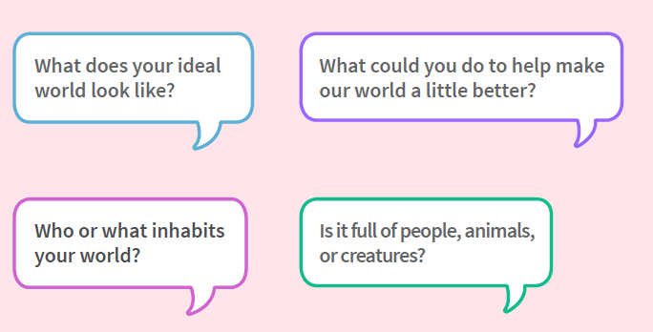
Step 2: How Does it Work?

Slide 19
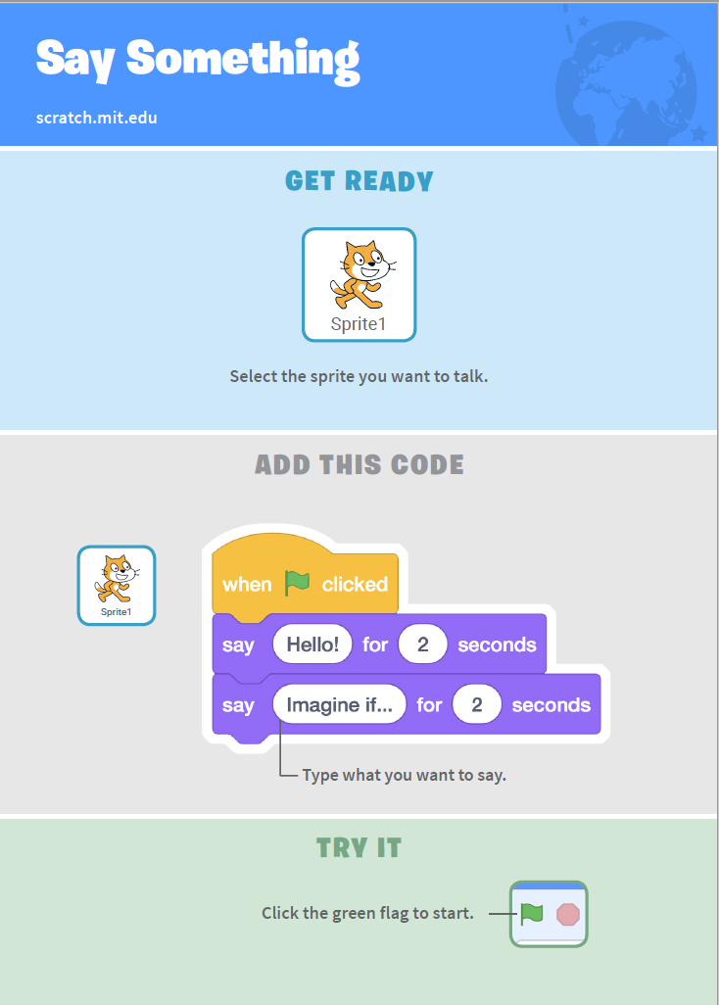
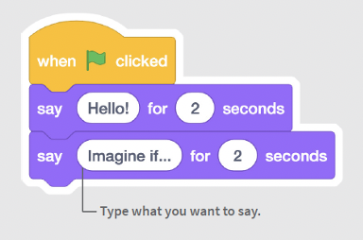
Step 3: Read It and Code It

Slide 20
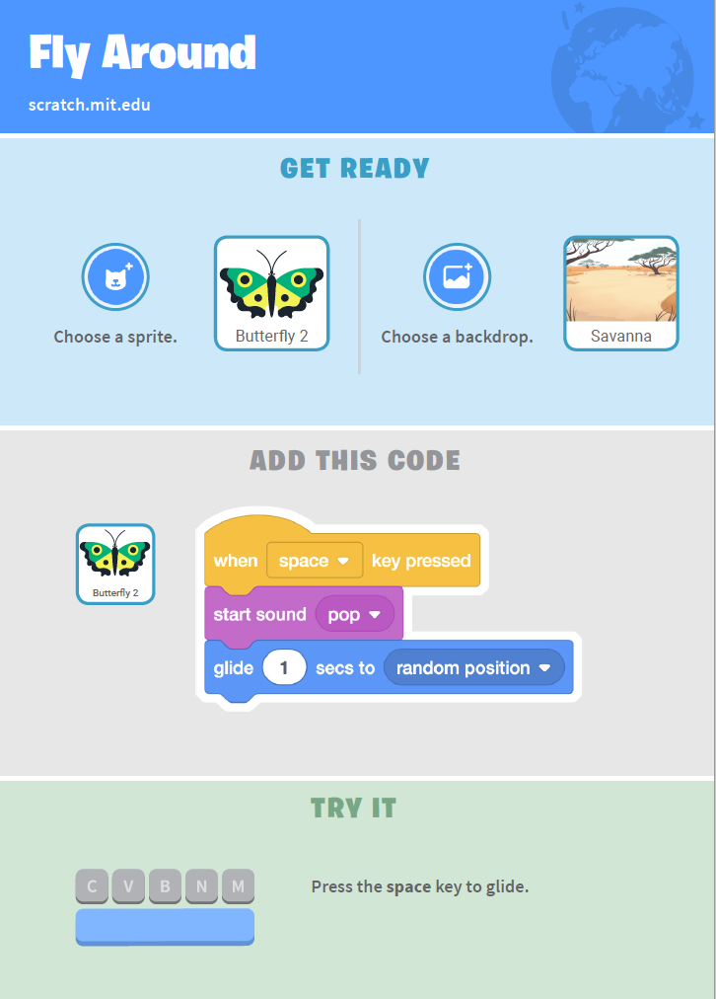
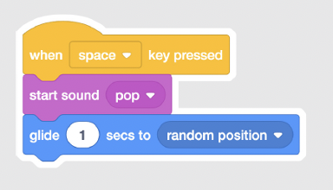
Step 3: Read It and Code It

Slide 21
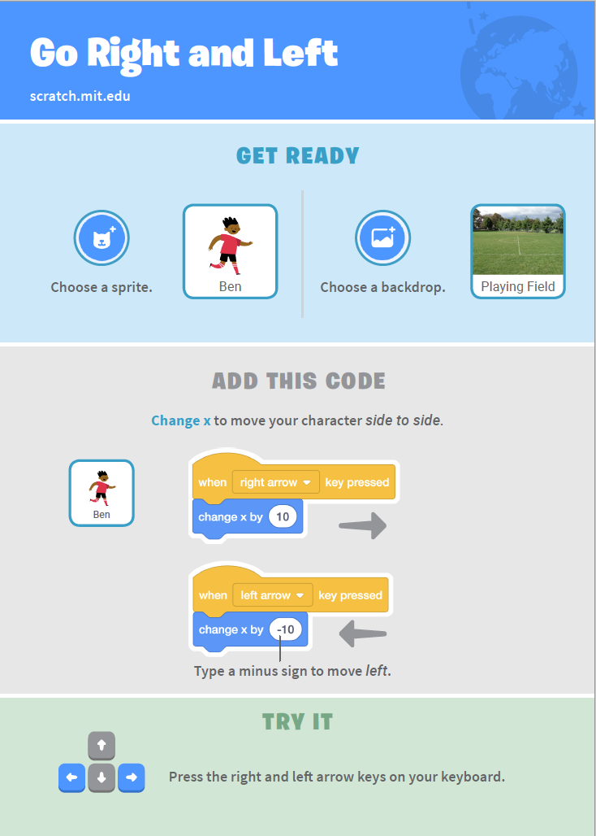
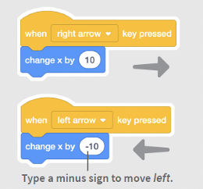
Step 3: Read It and Code It

Slide 22
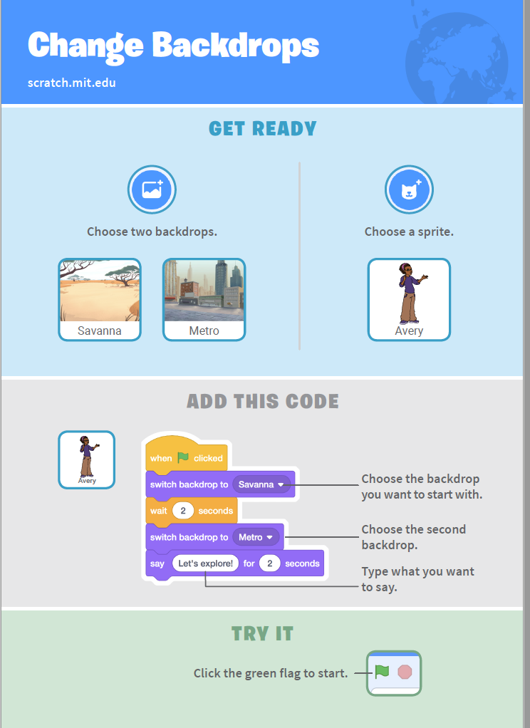
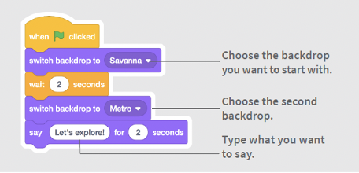
Step 3: Read It and Code It

Slide 23
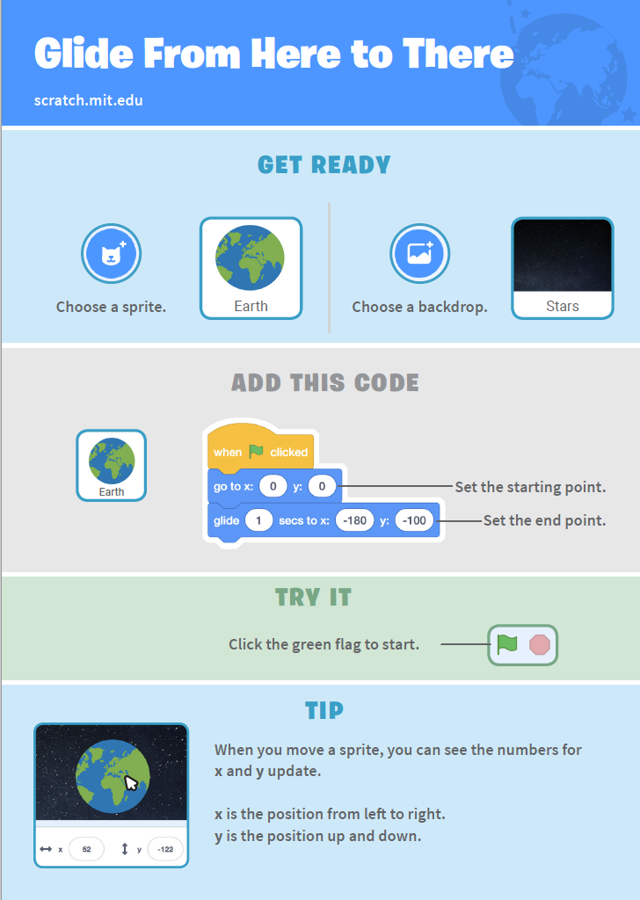
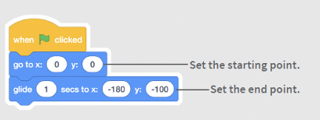
Step 3: Read It and Code It

Slide 24
Step 4: Share Your Creation!

Slide 25
Step 5: Improve It
Ask a fellow Micro-Maker one thing you could do to improve your world and try it out!

Slide 26
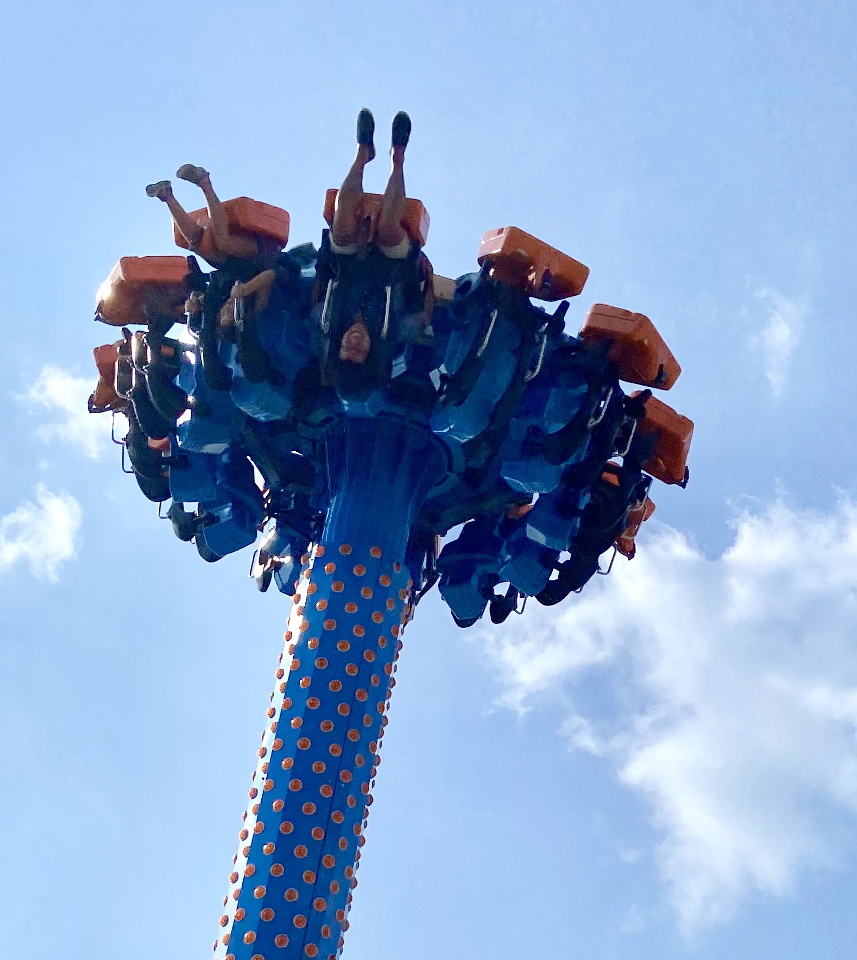
SKILL BADGE
World Building
YOUR MISSION
Use Scratch to recreate a world from your favorite book! Requirements:
1 background
2 characters that:
Talk to each other
Move from one point on the screen to another
1 object that the user can move around the screen themselves.

Slide 27
TIME TO PUT AWAY OUR COMPUTERS!
Neat and tidy, please!
Let’s leave this beautiful room as lovely as we found it!

Slide 28

UNTIL NEXT TIME….
MicroMakers!
Slides and Script: Holly Krambeck (learningpython64@gmail.com)
Project Videos, Images, and Text:
https://scratch.mit.edu/

